Slide 1

MANAGEMENT
Lecturer: Ilona Kojelytė
Vilniaus kolegija/University of Applied Sciences

Slide 2
Literature
Fundamentals of Management. Ricky W. Griffin
The New Era of Management. Richard L. Daft
Strategies & Application of Managerial Communication. G.E. Hynes
Skills Development for business and management students. K. Gallagher

Slide 3
The course includes:
Organization and management
Management science development
Organizations, their types, elements and internal processes.
Managerial decisions
Management functions
Human resources management
Leadership. Motivation.
Team work organization

Slide 4

I. Organization and Management
What is Management?
In all business and organizational activities is the act of getting people together to accomplish desired goals and objectives efficiently and effectively.

Slide 5
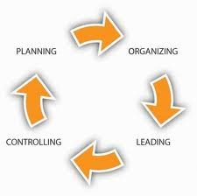

Slide 6
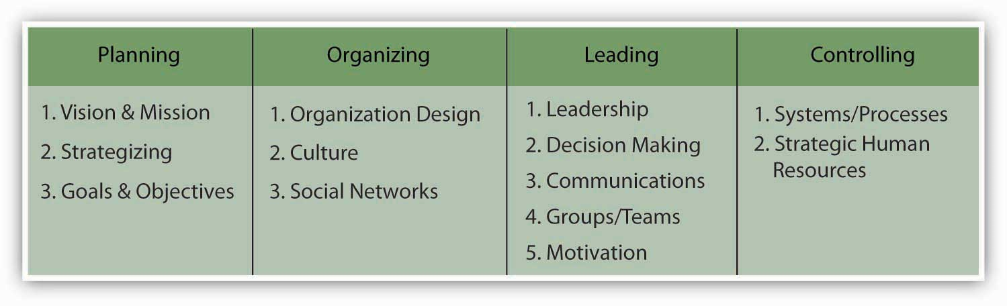

Slide 7
History
The verb manage comes from the Italian maneggiare (to handle — especially tools), which in turn derives from the Latin manus (hand). The French word mesnagement (later ménagement) influenced the development in meaning of the English word management in the 17th - 18th century.

Slide 8
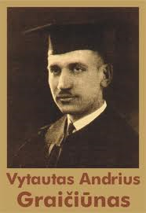
Vadyba

Slide 9
Vytautas Andrius Graičiūnas (August 17, 1898 in Chicago – January 9, 1952 in Olzher, Siberia) was a Lithuanian management theorist, management consultant and engineer. Born to Lithuanian immigrants, he studied at the University of Chicago. After coming back in 1919, he became interested in management and continued his studies at the Illinois Institute of Technology.

Slide 10
In 1927 he came to Lithuania and worked at several Kaunas factories. Soon he started traveling and working across Europe. Until 1935 he worked as a consultant and helped to establish large companies in Barcelona, Brussels, Copenhagen, London and Milan. During this period he published his classical study printed in Geneva - Relationship in Organization in 1933. Soon other editions appeared in the United States.

Slide 11
He mathematically proved that a manager should not have more than 4-5 subordinates. He came up with the following formula to express the total number of relationships between a boss and his or her subordinates:
N [(2^{N}/2) + N - 1], where N is a number of subordinates.

Slide 12
When number of subordinates increases, the number of relationships increases exponentially: at 5 subordinates the number of relationships is 100, at 10 - 5,210. Many scientists expanded or criticized the theory.

Slide 13
In 1935 Graičiūnas returned to Lithuania, where he worked as an engineer, management consultant at various state and private institutions, including Ministry of Defense, Lithuanian aviation, Lithuanian State Theatre, Lithuanian Film Company. He also lectured at the Vytautas Magnus University and was awarded Commander's Cross of Order of the Lithuanian Grand Duke Gediminas.

Slide 14
In 1951 while visiting Moscow with a group of students he visited the embassy of the United States where he was told that only he could leave the Soviet Union because his wife, actor Unė Babickaitė, did not have U.S. citizenship. After this incident Graičiūnas and his wife were arrested for espionage and anti-soviet activities, tried and sent to several years in GULAG. He died the following year under unclear circumstances.

Slide 15
Some definitions of management are:
1. Organization and coordination of the activities of an enterprise in accordance with certain policies and in achievement of clearly defined objectives. Management is often included as a factor of production along with machines, materials, and money.

Slide 16
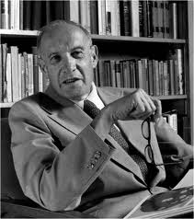
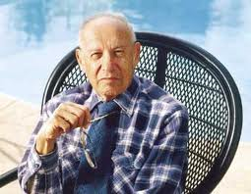
According to the management guru Peter Drucker (1909–2005), the basic task of a management is : marketing and innovation.

Slide 17
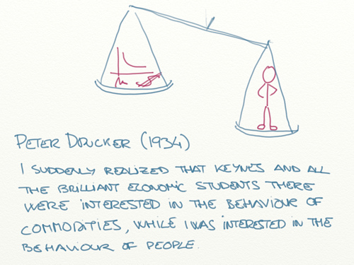

Slide 18
2. Directors and managers have the power and responsibility to make decisions to manage an enterprise.
As a discipline, management comprises the interlocking functions of formulating corporate policy and organizing, planning, controlling, and directing the firm's resources to achieve the policy's objectives.

Slide 19
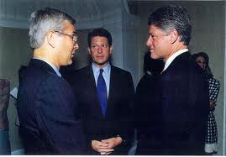
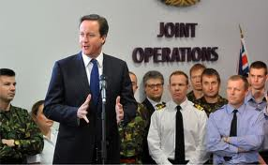
Management science is the application of the scientific method to address problems and decisions that arise in the business community and other organizations, such as government and military institutions.

Slide 20
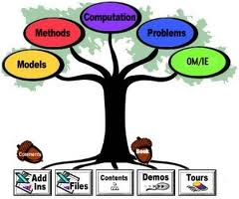
This field of study, which is also commonly known as operations research (OR), operates on the understanding that business managers can make informed decisions only when they have access to scientifically acquired knowledge.

Slide 21
To gain such knowledge, practitioners of management science undertake the major steps of scientific inquiry:
(1) identify the issue or problem,
(2) formulate a hypothesis (theory) about possible solutions to the problem,
(3) construct appropriate models to test the hypothesis,
(4) collect and analyze the results of the tests,
(5) determine the best way to resolve the issue or address the problem based on the final results.

Slide 22
Frederick Taylor
Frederick Winslow Taylor was an American mechanical engineer who lived from 1856 to 1915. He brought an engineer’s viewpoint to the world of workplace productivity and applied engineering principles to the factory floor.
He was the first management consultant and the first to look at work and productivity scientifically. He is known as the father of Scientific Management and the efficiency movement.

Slide 23
Taylor’s Scientific Management attempts to find the most efficient way of performing any job. He believed that there were universal laws which governed efficiency and that these laws were independent of human judgment. The goal of Scientific Management was to find this “one best way” of doing things as efficiently as possible.
Taylor brought a very scientific approach to productivity. He did not value the human needs of workers. This can be seen from the following quotes:
…what the workmen want from employers beyond anything else is higher wages: what employers want from workmen most of all is low labor costs in manufacture.
Frederick Taylor

Slide 24
Because Taylor believed that workers were only motivated by pay and money, then:
Workers don’t usually enjoy work. Because of this, they need to be monitored and controlled closely. Essentially, Taylor believed that employees had a natural tendency to take it easy of slack off whenever they could. He called this natural soldiering.
To help with this, managers should break down each employee’s job into more manageable, bite-sized tasks.
Training should be given so that all employees perform these tasks in a standard way.
Workers should be paid based on how much they produce (piece rate).
This will create a win-win situation. Workers are incentivized to work hard to earn more and the businesses production is as efficient as it can be (profits are maximized).

Slide 25
Since Taylor’s Motivation Theory is based on managers telling employees what to do, it is closely related to an autocratic style of leadership.
It is also closely related to Douglas McGregor’s Theory X model of management, where it is assumed that employees are fundamentally lazy and unmotivated.
Taylor’s work heavily influenced production methods at the start of the 20th century. It formed the foundation upon which Henry Ford introduced his mass-production techniques to the production of cars.
Whilst Scientific Management, sometimes simply called Taylorism, may sound obsolete, it is actually still in use today. This is especially so if you need to remain competitive in a labor-intensive industry by keeping costs as low as possible.

Slide 26
Theoretical scope
At the beginning, one thinks of management functionally, as the action of measuring a quantity on a regular basis and of adjusting some initial plan; or as the actions taken to reach one's intended goal.

Slide 27

This applies even in situations where planning does not take place. From this perspective, frenchman Henri Fayol (1841–1925) considered management to consist of 5 functions.

Slide 28
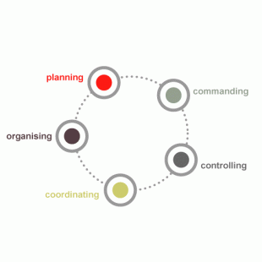

Slide 29
The Administrative Theory
Henri Fayol developed his theory of business administration between 1915 and 1925. H. Fayol created his theory, because he wanted to establish a consistent set of principles that managers could use, in order to lead their organizations properly. His theory was comprised of 14 principles and 5 functions of management.

Slide 30
Peter Drucker used most of the ideas that Henri Fayol established in his Administrative theory, when he created his Modern management theory.

Slide 31

These principles were similar to points addressed by P. Drucker in his theory, because they focused on treating the employees with more respect.

Slide 32

Both theories proposed the concept of the manager as the influential leader, which was acknowledged as one of the most important factors in maintaining a successful management system.

Slide 33
Thanks to scientists like Henri Fayol (1841-1925) the first foundations were laid for modern scientific management.
These first concepts, also called principles of management are the underlying factors for successful management.
Henri Fayol explored this comprehensively and, as a result, he synthesized the 14 principles of management.
Henri Fayol ‘s principles of management and research were published in the book ‘General and Industrial Management’ (1916).

Slide 34
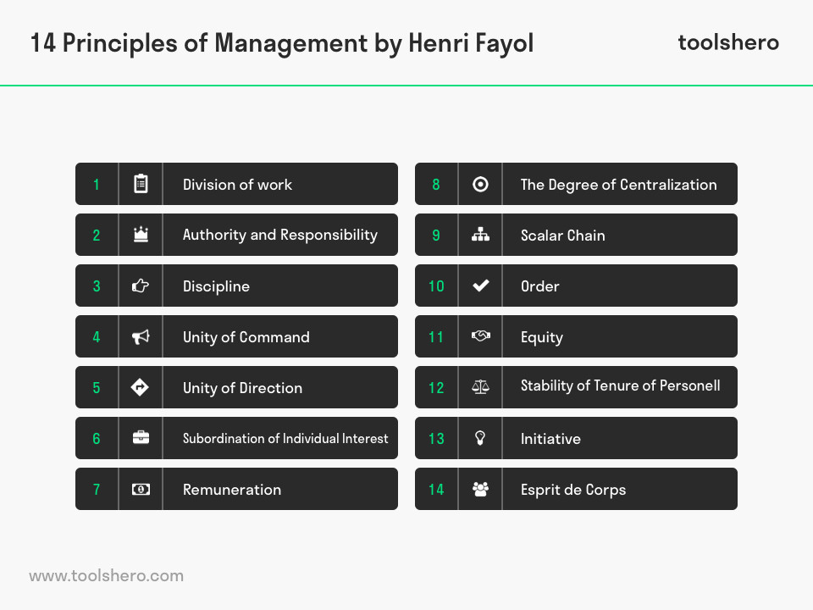

Slide 35
14 Principles of Management of Henri Fayol
Division of Work. Specialization allows the individual to build up experience, and to continuously improve his skills. Thereby he can be more productive.
Authority. The right to issue commands, along with which must go the balanced responsibility for its function.

Slide 36
3. Discipline. Employees must obey, but this is two-sided: employees will only obey orders if management play their part by providing good leadership.
4. Unity of Command. Each worker should have only one boss with no other conflicting lines of command.
5. Unity of Direction. People engaged in the same kind of activities must have the same objectives in a single plan. This is essential to ensure unity and coordination in the enterprise. Unity of command does not exist without unity of direction but does not necessarily flows from it.

Slide 37
6. Subordination of individual interest (to the general interest). Management must see that the goals of the firms are always paramount.
7. Remuneration. Payment is an important motivator although by analyzing a number of possibilities, H. Fayol pointed out that there is no such thing as a perfect system.

Slide 38
8. Centralization (or Decentralization). This is a matter of degree depending on the condition of the business and the quality of its personnel.
9. Scalar chain (Line of Authority). A hierarchy is necessary for unity of direction. But lateral communication is also fundamental, as long as superiors know that such communication is taking place. Scalar chain refers to the number of levels in the hierarchy from the ultimate authority to the lowest level in the organization. It should not be over-stretched and consist of too-many levels.
.

Slide 39
10. Order. Both material order and social order are necessary. The former minimizes lost time and useless handling of materials. The latter is achieved through organization and selection.
11. Equity. In running a business a ‘combination of kindness and justice’ is needed. Treating employees well is important to achieve equity.

Slide 40
12. Stability of Tenure of Personnel. Employees work better if job security and career progress are assured to them. An insecure tenure and a high rate of employee turnover will affect the organization adversely.
13. Initiative. Allowing all personnel to show their initiative in some way is a source of strength for the organization. Even though it may well involve a sacrifice of ‘personal vanity’ on the part of many managers.

Slide 41
14. „Esprit de Corps“. Management must foster the morale of its employees. He further suggests that: “real talent is needed to coordinate effort, encourage keenness, use each person’s abilities, and reward each one’s merit without arousing possible jealousies and disturbing harmonious relations.”

Slide 42
The Peter Drucker theory of management embodies many modern management practices.
Peter Drucker, also known as the Father of Modern Management Theory, coined terms and strategies that are still used today.
Peter Drucker, also known as the Father of Modern Management Theory, coined leadership terms and strategies that are still used today. He advocated for a more flexible, collaborative workplace, and the delegation of power across the board.
According to P. Drucker, "management is doing things right; leadership is doing the right things." Unlike many early management theorists, P. Drucker thought that subordinates should have the opportunity to take risks, learn and grow in the workplace.
P. Drucker's management theory embodies many modern concepts, including

Slide 43
Decentralization
Drucker was focused on decentralizing management in the workplace. He wanted all employees to feel valued and empowered, like their work and voice mattered. He believed in assigning tasks that inspire workers, and bringing supervisors and their subordinates together to achieve common, company goals.
Knowledge work
Knowledge workers are those whose jobs require handling or using information, such as engineers or analysts. Drucker placed high value on workers who solved problems and thought creatively. He wanted to cultivate a culture of employees who could provide insight and ideas.

Slide 44
Management by objectives
Drucker conceptualized "Management by Objectives" (MBO), a process that encourages employees of all levels to work together. Each worker has an equal say, sharing their own insight and opinions to reach common ground. From there, teams establish shared goals and delegate tasks according to skillsets and interests.
There are five steps of MBO:
Review goals
Set objectives
Monitor progress
Evaluate performance
Reward employees

Slide 45
S.M.A.R.T.
In his MBO practice, Drucker used S.M.A.R.T., a process coined by George T. Doran, that increases efficiency in work-related tasks. The acronym calls for each objective to be:
Specific
Measurable
Achievable
Relevant
Time-Oriented

Slide 46
P. Drucker was born in 9th of November, 1909 in Austria;
PhD in international law in Frankfurt University in 1932;
Moved to England, then USA (after marriage) in 1937;
Professor of management in New Yourk University from 1950;
P. Drucker published „The Practice of Management“ in 1954 – widely considered the first book to organize the art and science of running the organization into an integrated body of knowledge.

